Slide 1
IMDB Recommender Engine
Brendan Tan

Slide 2
Table of Contents
01
02
03
Project Objectives
Data Acquisition & Loading
Key Insights
04
Recommender Engine

Slide 3
01
Project Guidelines
Notes:
I will be bringing you through the project objectives

Slide 4

Project Objectives
1. To extract key business insights regarding the movie industry that benefits 2 stakeholders: IMDb and Film Producers
2. To build models that provide recommendations for users
Notes:
I had 2 objectives for the project. First is to extract any business insights that can benefit 2 stakeholders, namely IMDb and film producers in the industry. The second would be to build a recommendation engine for users

Slide 5
02
Data Acquisition & Manipulation

Slide 6
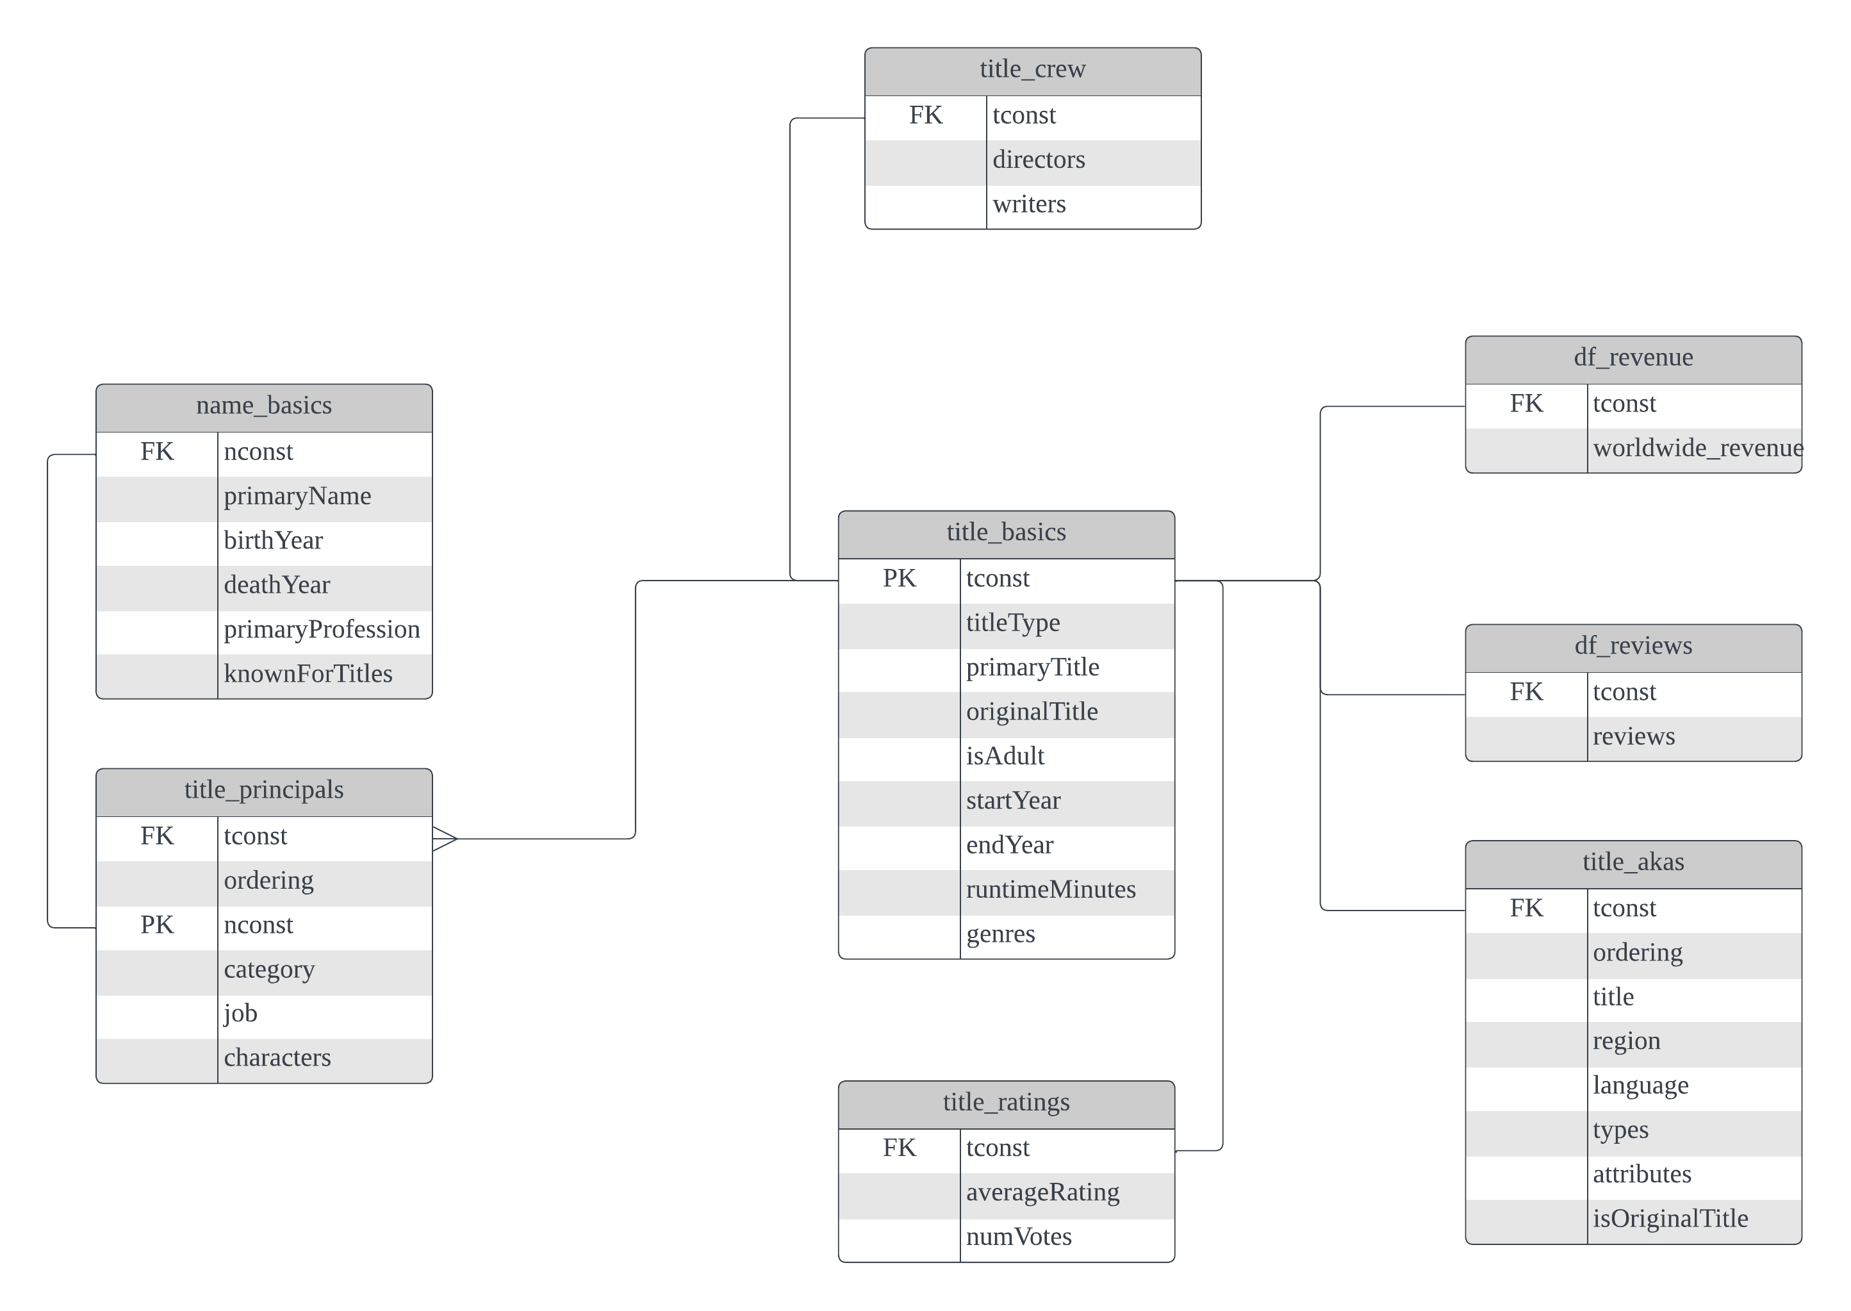
Data Acquisition
1. IMDb Non-Commercial Dataset (updated in mid-2023)
- Extracted from IMDb
Image above: Fact table for dataset used
Notes:
The main dataset that was extracted from the IMDb website is boxed up in black boxes, and this is the fact table for the dataset. The remaining 2 datasets were my attempts to scrape data from 2 other websites, which I will be explaining.

Slide 7
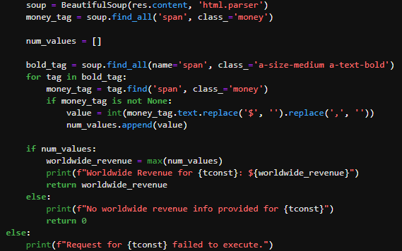
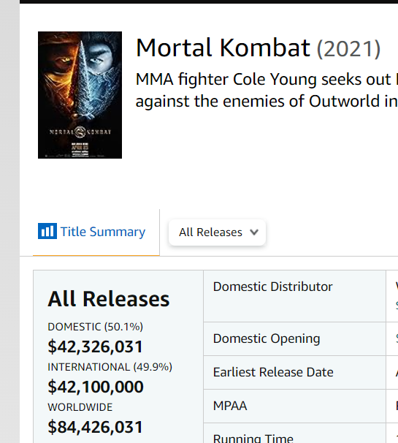
2. Scraped from boxofficemojo
Using requests, BeautifulSoup and Regex
Scraped worldwide revenue values for each movie
Purpose: To conduct an analysis on features of movies that earned high revenues
Notes:
I attempted to scrape the worldwide revenue earned by each movie using requests, BeautifulSoup and Regex to do some analysis on the characteristics of a high-revenue movie. However, there was a large majority (~70%) of movies that did not have worldwide revenue available. Hence, I did my analysis using the average rating and popularity scores of the movies instead.

Slide 8
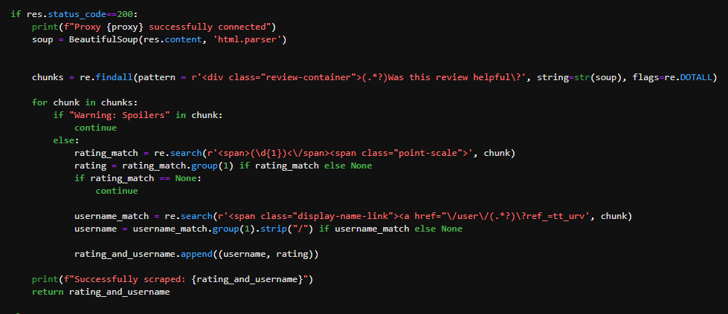
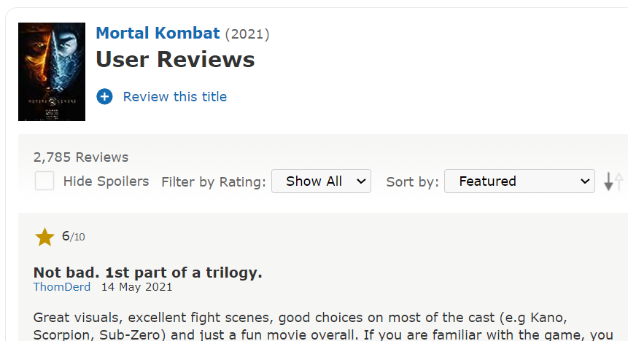
3. Scraped from IMDb
Scraped arrays of (user, rating) tuples for collaborative filtering recommender engine
Purpose: To build a user-based collaborative filtering recommender engine
Data had 99.94% sparsity and resultant recommender engine built using Keras got ~3.5 MSE (ie RMSE of ~1.87)
Notes:
Similarly, I attempted to scrape the user ratings from IMDb for the purpose of building a recommender engine using keras. However, due to computational limitations, I only managed to get 0.06% of the overall user ratings for my dataset. I still attempted to build the keras model but got quite a bad MSE of 3.5, hence I decided to scrap the use of this dataset.

Slide 9
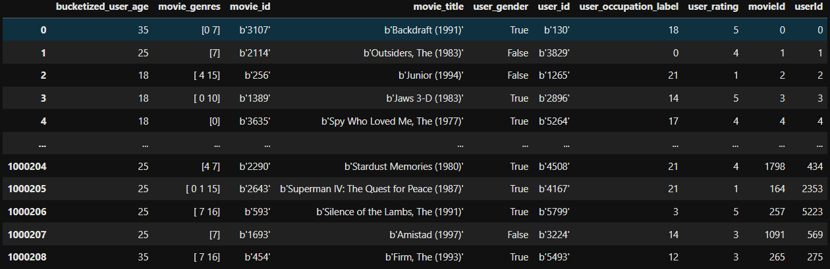
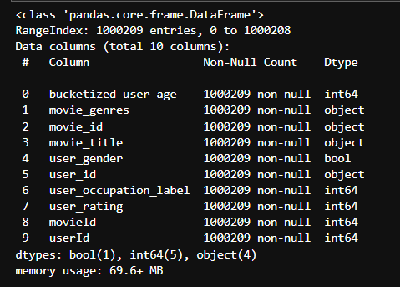
4. MovieLens 1m dataset
Replacement for dataset used for collaborative filtering model
Notes:
As a replacement to the previous dataset, I used the MovieLens 1m dataset instead which was readily available.

Slide 10
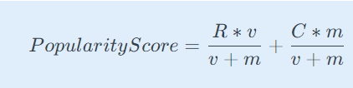

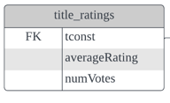
Feature Engineering
1. Popularity Score
2. Recommendation Propensity
Adding a time-decay factor k*(age/Year Range of dataframe)
Year range is 11 (ie 2013 to 2023) and
k is an arbitrary value (chosen 11). Age of movie taken as 2023 – (year of release)
Reco engine shortlists 30 movie selections and recommends top 3 movies with highest recprop value
2 components to popularity score
First component: R*v determines the total rating of the movie
Second component: C*m gives a baseline popularity level across all movies.
(v+m): serves as the normalization factor
Legend:
R – averageRating
v – numVotes
m – minimum votes required for movie to be considered (ie 1000)
C – mean rating across all movies
k – Arbitrary number (ie 11)
Image above: Fact table for dataset used
Notes:
Moving on to feature engineering, I engineered 2 additional features from the average rating and the number of votes for each movie. First is a popularity score, which comprises of 2 components. The second component calculates the baseline popularity score across all movies, and the first component carries the total rating of the movie. V + m, which is the number of votes and the minimum number of votes for the movie’s consideration, which serves as a normalization factor.
The second feature would be recommendation propensity, where I took the popularity score and added a time decay factor, which penalises the popularity score the older the movie is. This will ultimately be used by the recommendation engine by sorting according to descending rec prop and popularity score.
Overall mean numVotes – 3208
Movie’s max popularity is 10, and min is 0
Q: If a movie is very popular, but is shown 10 years ago, I would be less likely to want to recommend it over a newer movie that is less popular. Hence, I would give it the max penalty of 10. Working backwards, I derived the value of k/Year Range of DF to be 1, to give the maximum penalty to a movie that is old.
Magnitude of the decay term is relative to magnitude of popularity score – popscore has range of 0 to 10, and decay term also has range of 0 to 10.

Slide 11
03
Key Insights

Slide 12
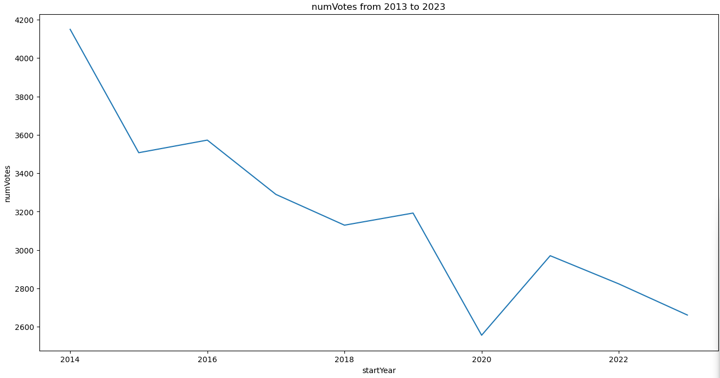
1. IMDb is declining in voters
IMDb’s business model revolves around advertising, sponsored content and subscription for industry professionals
Increased competition (Apple TV, Netflix etc)
IMDb: Consider collaboration with competition to mutually boost active users on both platforms
Notes:
The first insight I gleaned is that IMDb is possibly declining in user base, as seen from a decline in the average number of votes. This could be due to increased competition from other big players, like Apple TV and Netflix. To tackle this, one consideration would be for IMDb to collaborate with its competition to mutually boost the user base for both sites. Perhaps Netflix can have a feature that links to IMDb’s review system to review shows, since IMDb has been around for longer than Netflix and has built a user base for itself.

Slide 13
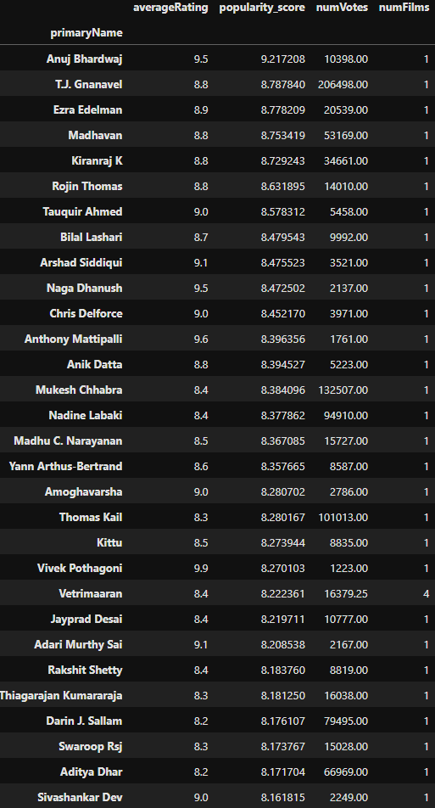
2. Producers of one-hit wonders
Several producers created singular movies that received very high popularity scores
IMDb: Can conduct a deeper analysis on commonalities of films produced (eg NLP on reviews, cast involved, regional analysis etc). Can also factor these attributes into their own rec engine
Film producers: Can recruit/consult these producers for the genre they will be producing
Notes:
Second, I looked at movies with the highest popularity scores and averageRatings, and noticed that many of the producers of these films only produced one film, or in other words are one hit wonders. This insight can translate into action for IMDb and film producers in the following ways.
For IMDb, they can conduct a deeper analysis on some commonalities of these films produced, perhaps using NLP, or by regoinal analysis etc, to gain more insight into what makes a film popular. Then, they can incorporate these insights to further improve their recommendation engine and improve user engagement on IMDb.
For film producers, they can consider consulting or even recruiting these producers for production.

Slide 14
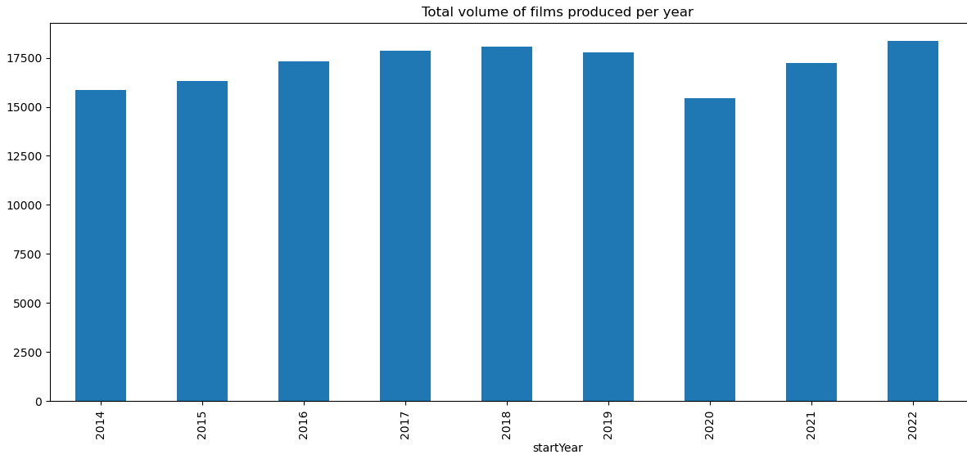
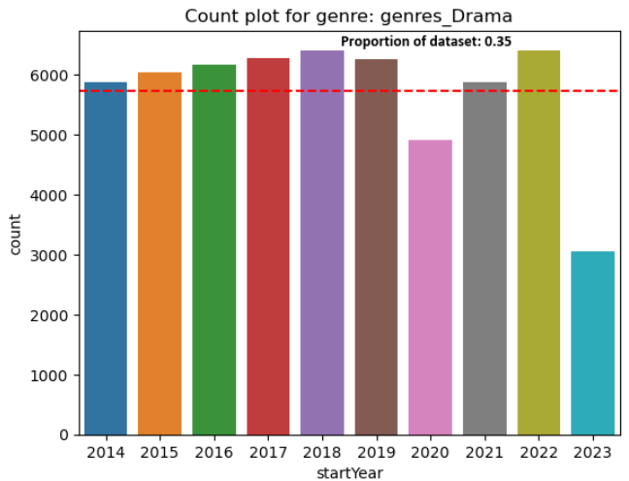
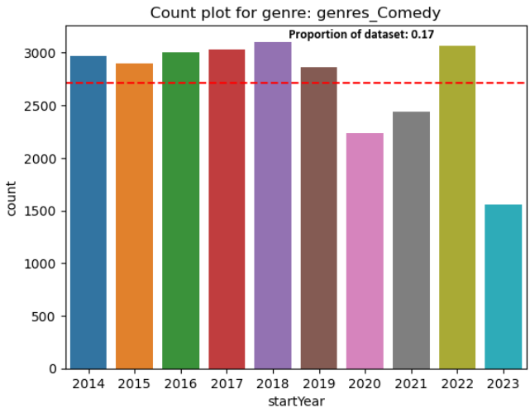
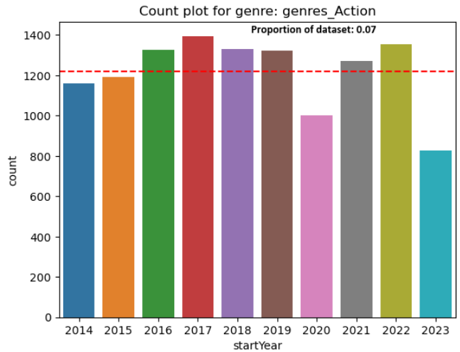
Film production decreased in 2019/2020 when COVID hit, but rebounded in 2021 and 2022
3. Film production is rebounding to higher heights
Majority of the production between 2021 and 2022 came from Drama, Horror and Action genres
IMDb: Opportunity for IMDb to segment and target specific users to increase user engagement, as more films produced means more opportunities for users to rate and comment on videos.
Film producers : Increased competition/opportunities for collaboration
Notes:
Thirdly, I did an exploration on the overall volume of film production. Film production declined in 2019 and 2020 when COVID hit, but quickly rebounded in 2021 and 2022, with the main contributors being from the drama, comedy and action genres.
Through the segmentation of movies by genre, IMDb can capitalize on this by targeting specific user groups who have logged in, with the genres they prefer using their recommendation engine, which can potentially improve user engagement levels.
As for film producers, this increase in volume of production signals 2 things, that there is an increased level of competition and also increased opportunities for collaboration for film production.

Slide 15
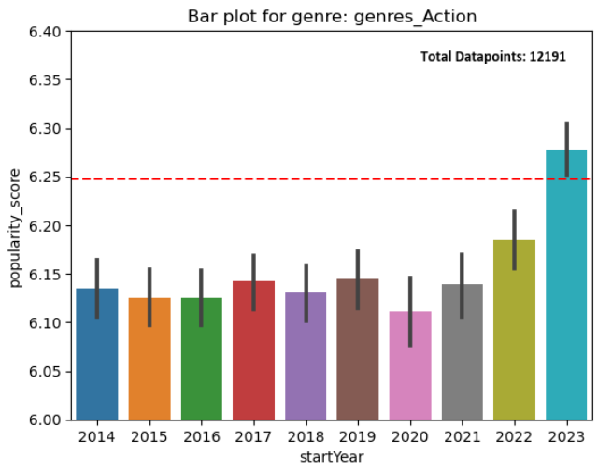
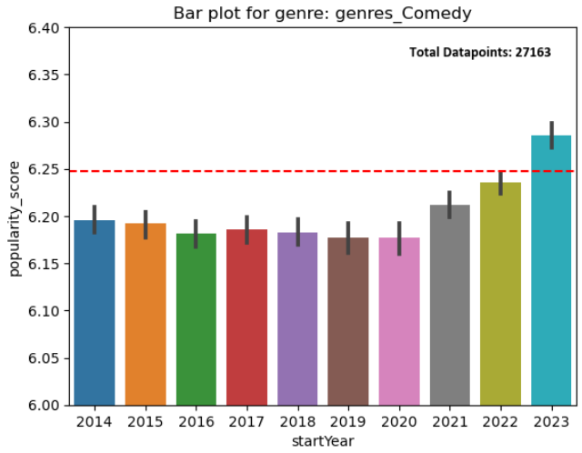
4. Genre trends with rising popularities
Action and Comedy films are rising in popularity (with both genres rising above the mean popularity recently)
IMDb: Can consider showcasing hot action/comedy films on landing site
Film producers: Can consider producing films of these genres
Notes:
Lastly, I did an analysis on the genres of movies produced, with regards to how the popularity score changes over time. I noticed that 2 particular genres, namely comedy and action, were also rising in average popularity scores amidst the 2021 to 2022 rebound. To note, for 2023, as the timeframe of the data was only till middle of 2023, the spike in average popularity score may not be as statistically significant as the previous 2 years.
So, the actionable insight for IMDb would be to consider showcasing hot action or comedy films on their landing page to capitalize on the rising trend in average popularity scores for these genres, potentially attracting a larger audience and enhancing user engagement.
As for film producers, they can focus on creating and promoting more action and comedy films, which may enhance the films' visibility, audience reception, and overall success in the film industry.

Slide 16
04
Recommender Engine

Slide 17
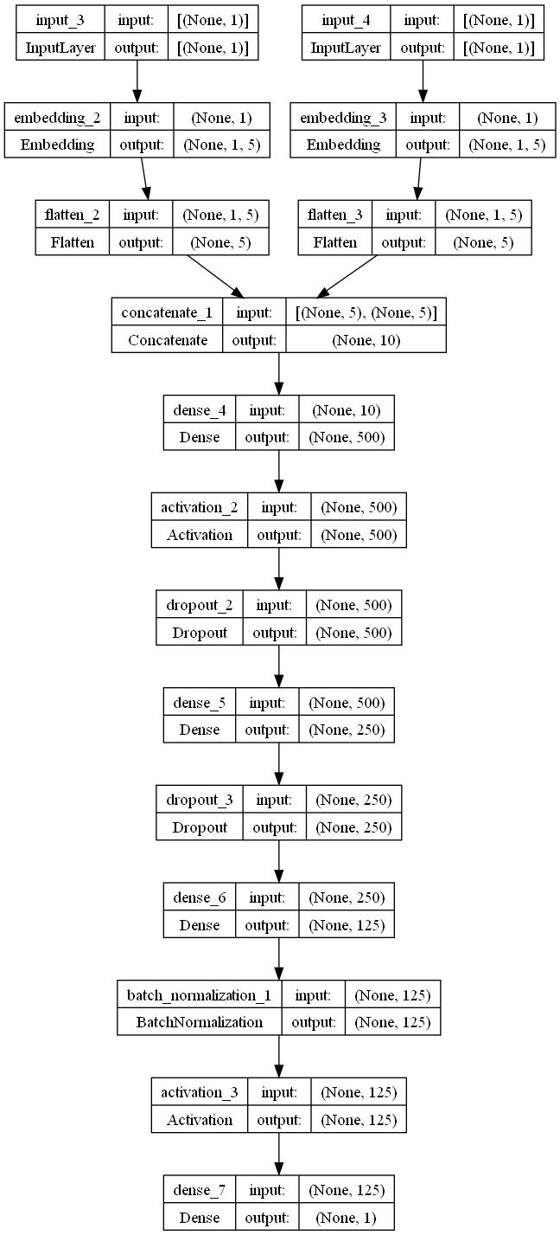
Models Created
Cosine-similarity model
Keras
- User inputs 3 movies they enjoy
- Model will calculate cosine similarity scores with movies in database
- Sorted by highest popularity scores and recommendation propensity, returning top 5 movies
- Trained using MovieLens 1m dataset
- Model takes 2 inputs: user index and movie index
- Passes the inputs through NN architecture and predicts a user rating
- val_mse of 0.94
Notes:
I built 2 recommender engines. The first is a simple cosine-similarity model, where users will first input 3 movies that they enjoy. The model will then calculate a cosine similarity score with the movies in the database, output the top 30 highest scores, sorted in descending order by popularity scores and recommendation propensity, and then returning the top 5 movies.
The second is a keras model, where the model will take a user and movie id pair, and then output a predicted user rating. I got a validation MSE of about 0.94, which is an RMSE of around 1. The model can be further improved, perhaps by hyperparameter optimization using keras-tuner, or feature engineering or collecting more data.

Slide 18
Thanks!
Please keep this slide for attribution

